Slide 1

Student Homelessness in
New York City Public Schools
District 75, SY 2015–16

Slide 2
Student Homelessness in NYC
Nearly 100,000 NYC public school students experienced homelessness during SY 2015-16.
Unless current trends change,
1 in 7 students will experience homelessness before they finish elementary school.
Source: New York City Department of Education, unpublished data tabulated by the Institute for Children, Poverty, and Homelessness, SY 2015–16.
Notes:
Student Homelessness in NYC

Slide 3
Where Do Homeless Students Sleep?
For every homeless student
living in shelter, roughly two more are homeless living in another temporary
setting—mostly doubled up.
Source: New York City Department of Education, unpublished data tabulated by the Institute for Children, Poverty, and Homelessness, SY 2015–16.

Slide 4
Most Children Are Homeless for More Than One School Year
Homelessness was not a
brief or isolated experience
for students citywide.
Two-thirds of homeless students experienced homelessness during more than one school year.
Source: New York City Department of Education, unpublished data tabulated by the Institute for Children, Poverty, and Homelessness, SY 2015–16.

Slide 5
Young Students Are Most at Risk
Students are more likely to experience homelessness when they are young.
During SY 2015–16, 35% of all homeless students were in grades pre-K through 2nd compared to 28% of housed students.
Source: New York City Department of Education, unpublished data tabulated by the Institute for Children, Poverty, and Homelessness, SY 2015–16.

Slide 6
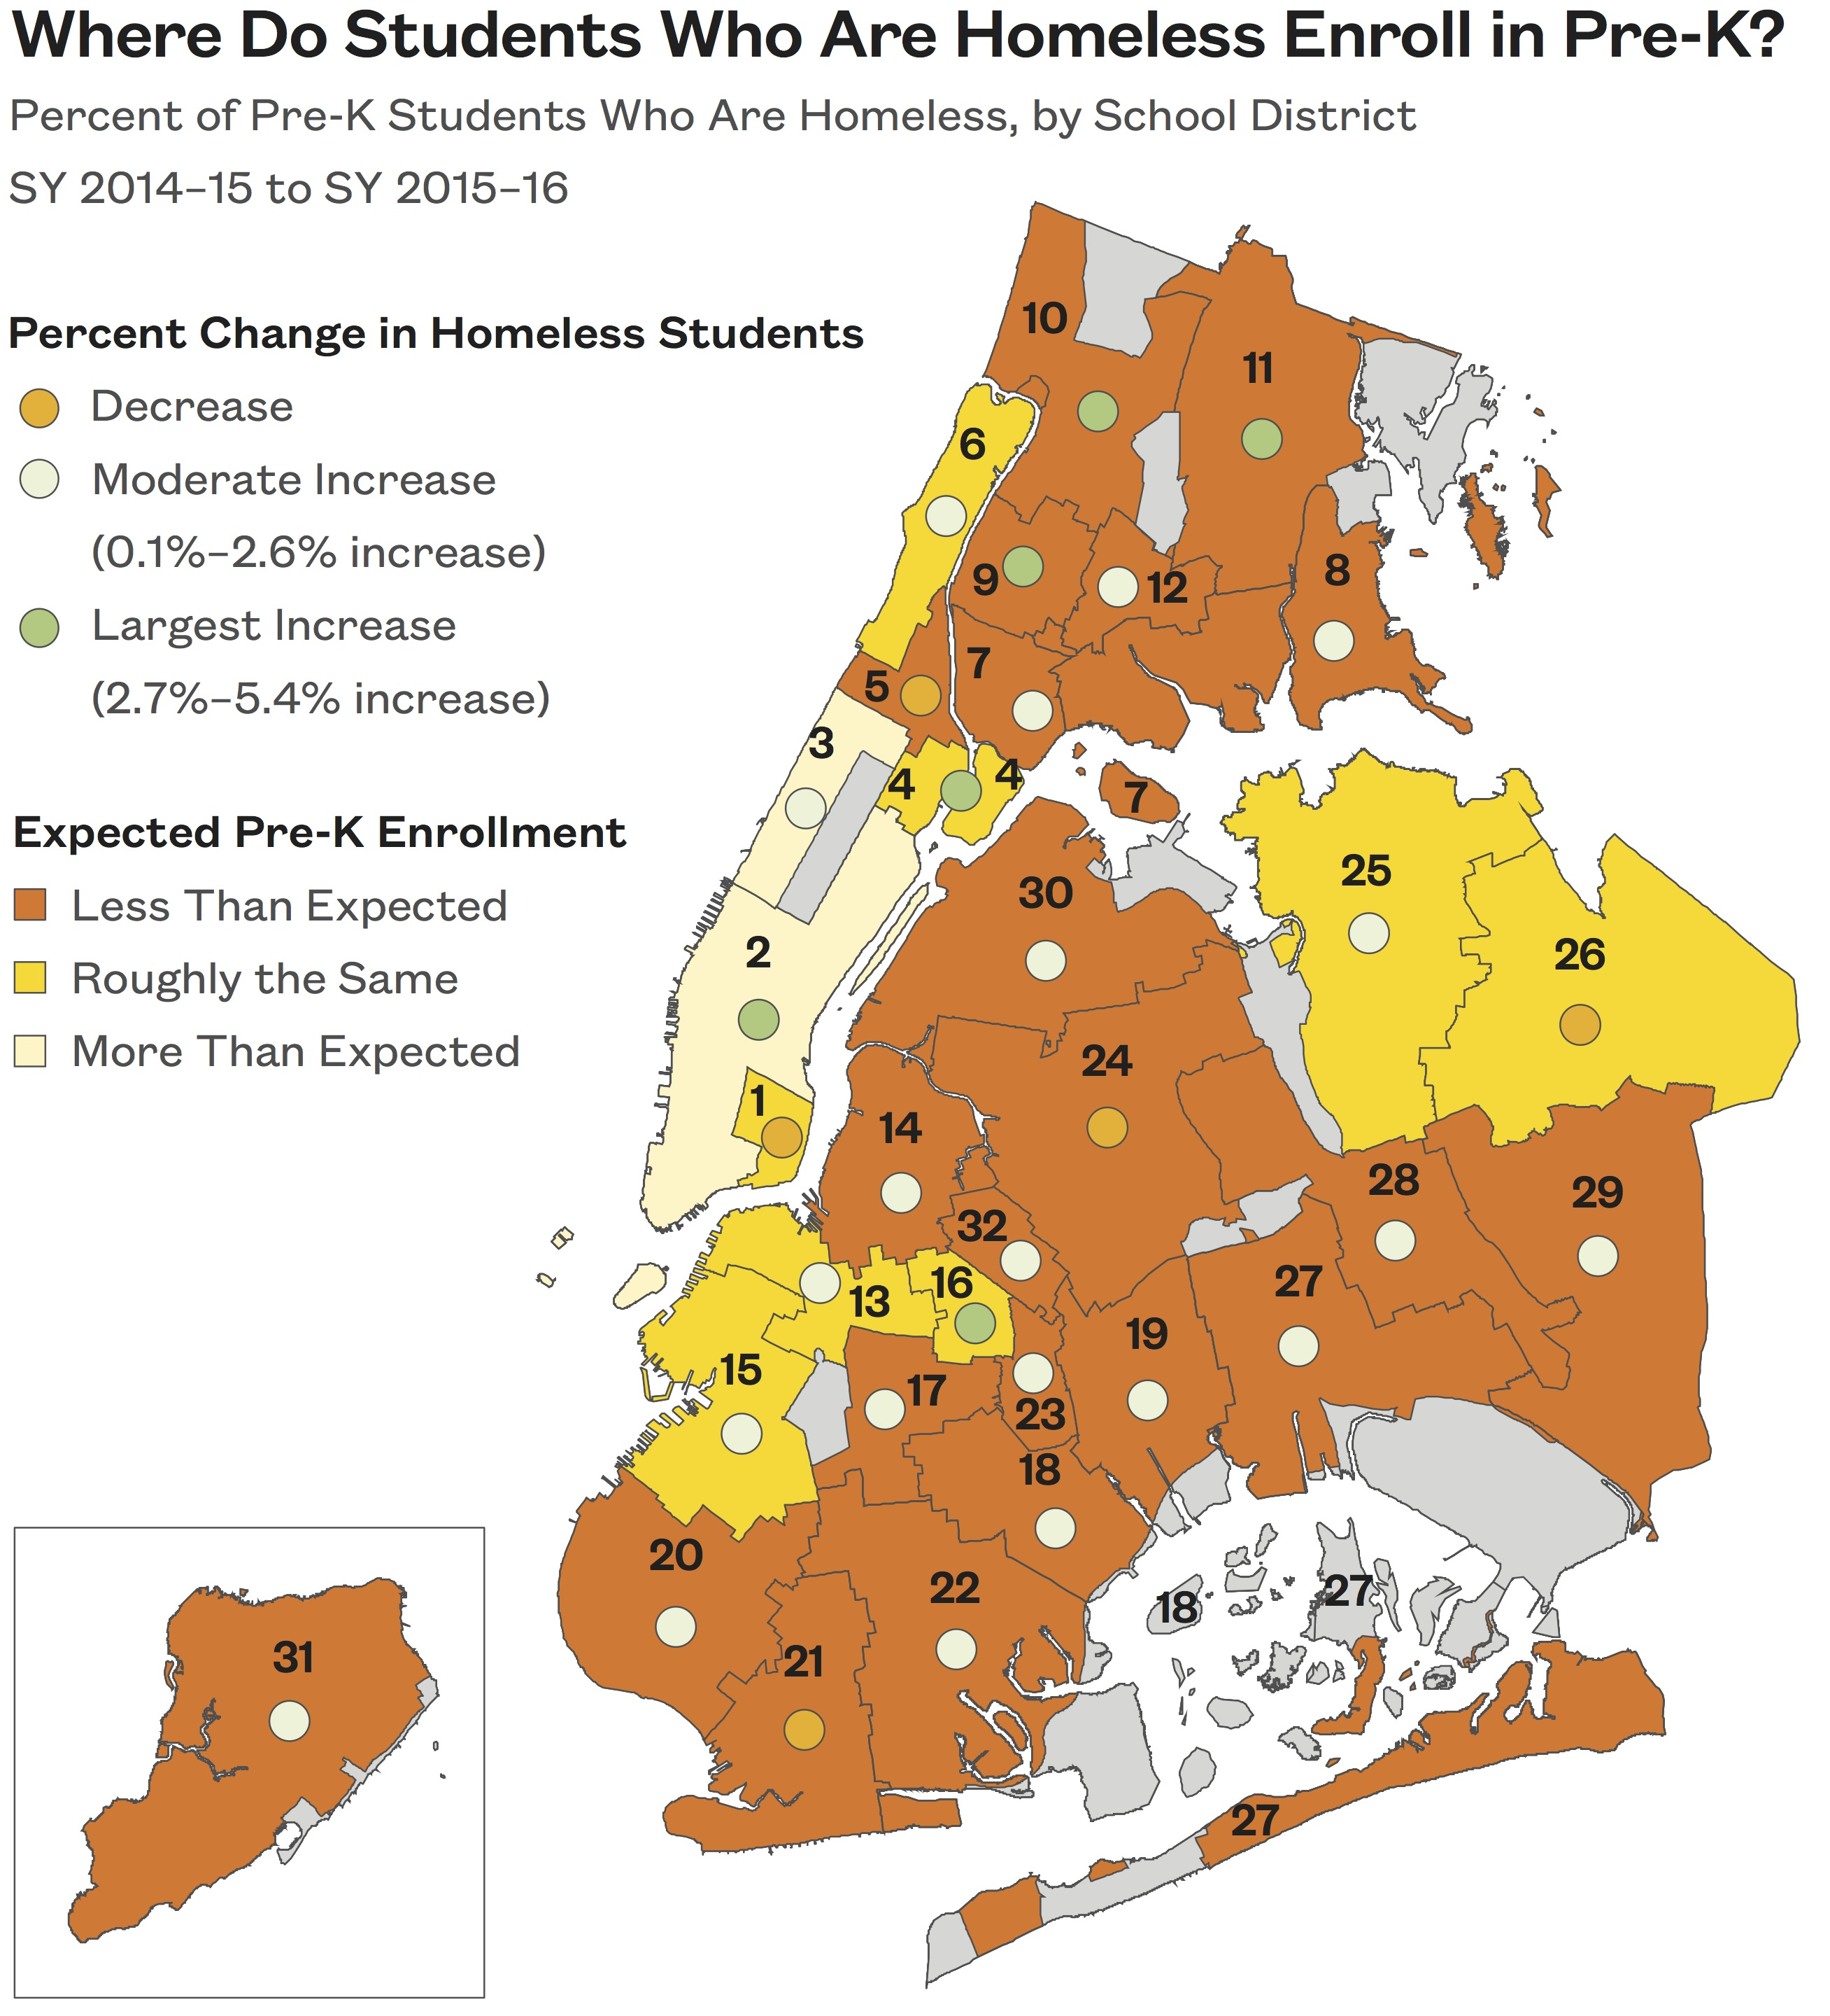
Differences in Pre-K Enrollment
Citywide, pre-K enrollment improved by 17%. However, the majority of school districts enrolled fewer homeless pre-K students than would be expected.
Source: New York City Department of Education, unpublished data tabulated by the Institute for Children, Poverty, and Homelessness, SY 2015–16.

Slide 7

Student Homelessness in District 75: Citywide Special Education
Over 2,200 currently homeless students enrolled in District 75.
1 in 5 students experienced homelessness in the last six years.
Source: New York City Department of Education, unpublished data tabulated by the Institute for Children, Poverty, and Homelessness, SY 2015–16.
Notes:
School-age children only
Does not include charter schools

Slide 8
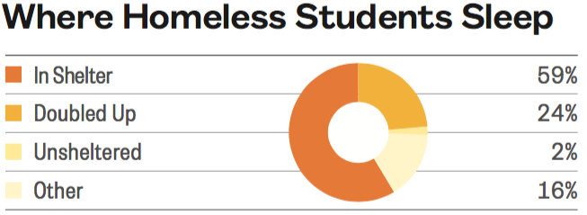
Where Do Homeless Students Sleep in District 75?
1,333 students lived in shelters and 533 students lived doubled up at some point during SY 2015–16. Another 399 students lived in another temporary setting.
Source: New York City Department of Education, unpublished data tabulated by the Institute for Children, Poverty, and Homelessness, SY 2015–16.

Slide 9
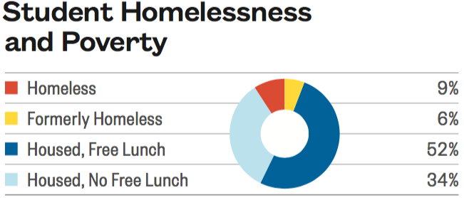
Homelessness and Poverty Among Students in District 75
Among students enrolled, 9% were homeless during SY 2015–16.
Another 6% had been homeless in at least one of the five previous years.
Source: New York City Department of Education, unpublished data tabulated by the Institute for Children, Poverty, and Homelessness, SY 2015–16.

Slide 10
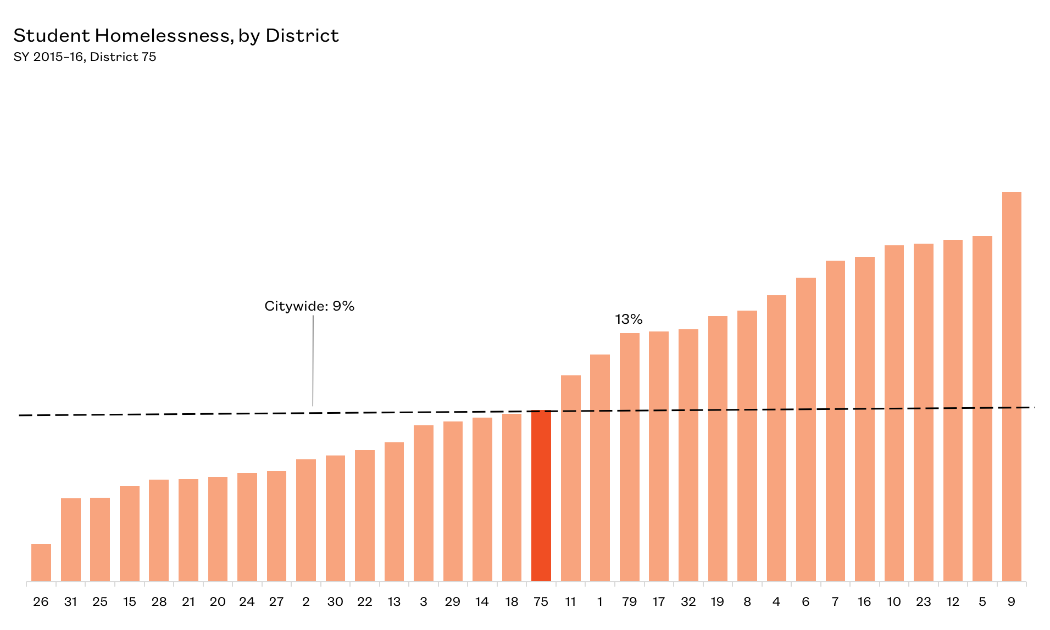
Percentage of Homeless Students in District 75
District 75 has a homelessness rate consistent with the citywide average of 9%.
Source: New York City Department of Education, unpublished data tabulated by the Institute for Children, Poverty, and Homelessness, SY 2015–16.

Slide 11
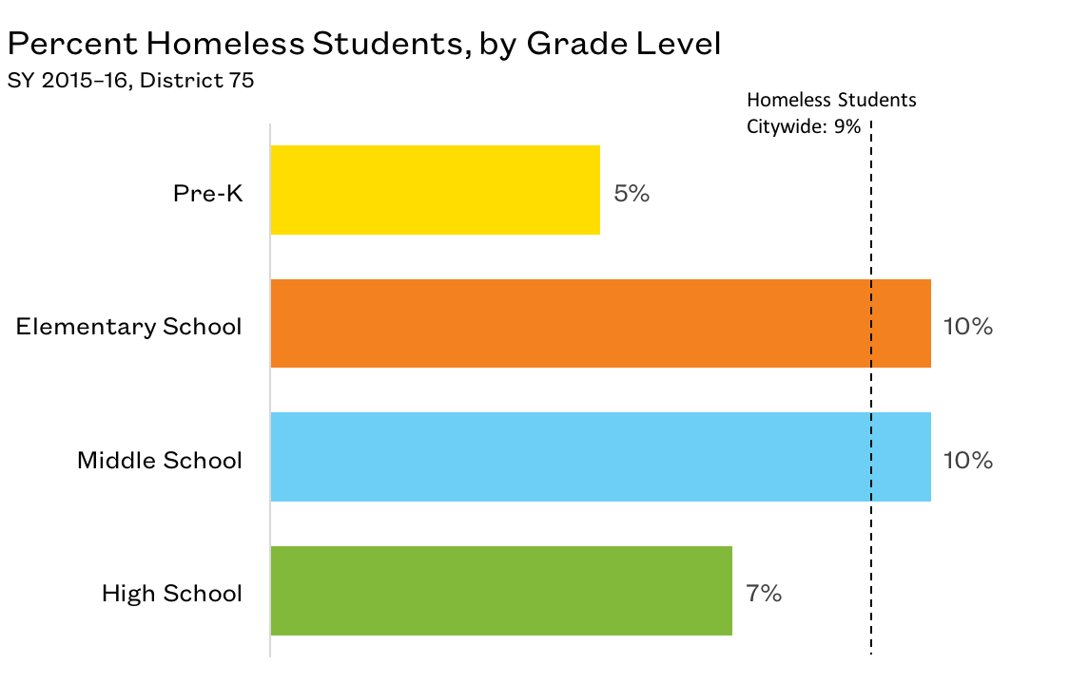
Young Students Are Most At Risk
Elementary schools and middle schools had the highest percentage of homeless students in District 75.
Source: New York City Department of Education, unpublished data tabulated by the Institute for Children, Poverty, and Homelessness, SY 2015–16.

Slide 12
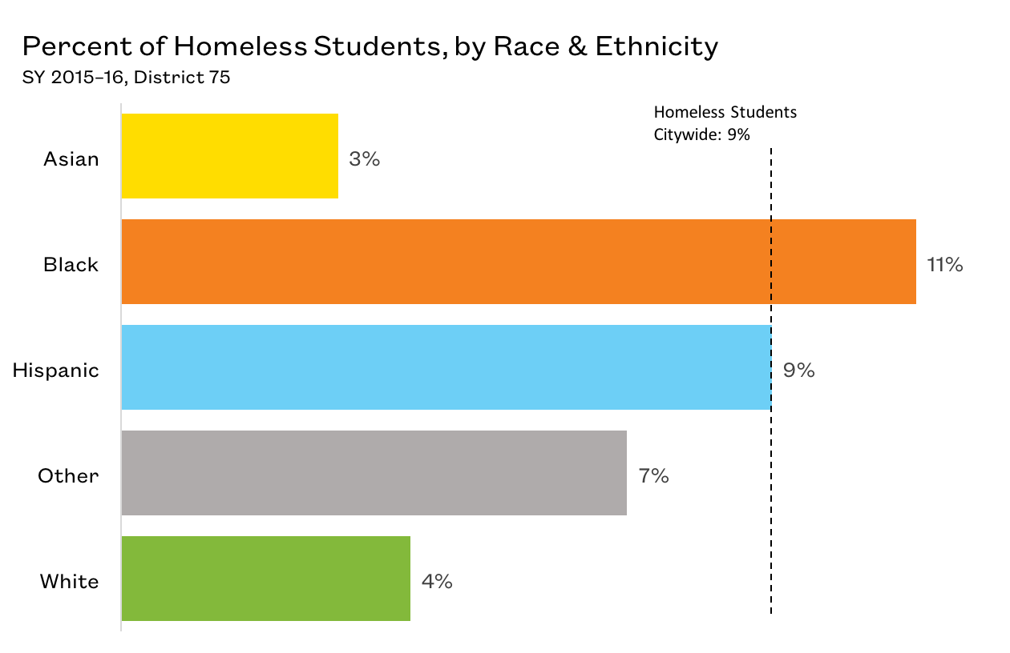
Student Homelessness by Race and Ethnicity in District 75
Black students were most at risk of experiencing homelessness in District 75.
Source: New York City Department of Education, unpublished data tabulated by the Institute for Children, Poverty, and Homelessness, SY 2015–16.

Slide 13
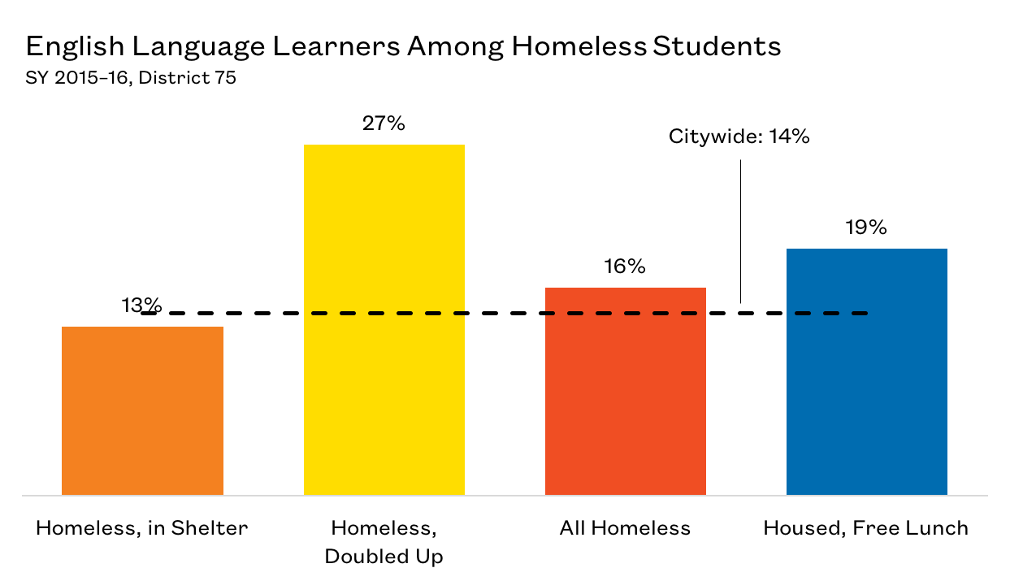
English Language Learners in District 75
16% of homeless
students were English Language Learners.
Source: New York City Department of Education, unpublished data tabulated by the Institute for Children, Poverty, and Homelessness, SY 2015–16.

Slide 14
Impacts of Student Homelessness
  Transfer schools more often
  More likely to be chronically absent
  Lower rates of proficiency on state assessments
  Higher suspension rates
  Lower graduation rates
  Higher dropout rates
  Require additional ELL supports
  Receive late support for special education needs
These impacts last beyond a student’s experience with homelessness

Slide 15
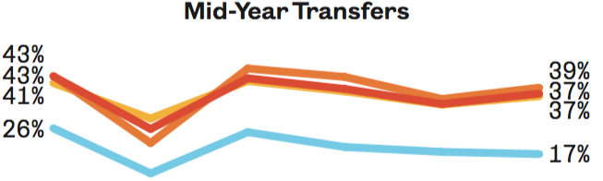

Mid-Year School Transfers in District 75
Almost 40% of homeless students transferred schools mid-year.
Students in shelters had the highest mid-year transfer rate at 39%.
Every school transfer is
estimated to set a student
back academically by
up to six months.
SY 2010–11
SY 2015–16
Source: New York City Department of Education, unpublished data tabulated by the Institute for Children, Poverty, and Homelessness, SY 2015–16.

Slide 16
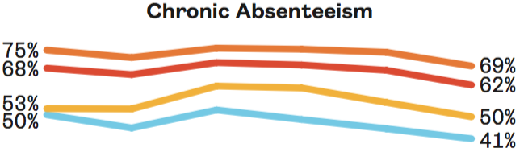

Chronic Absenteeism Among Homeless Students in District 75
Students who are chronically absent miss 20 or more
days of school in a year.
Almost 70% of students living in shelters were chronically absent in District 75.
Source: New York City Department of Education, unpublished data tabulated by the Institute for Children, Poverty, and Homelessness, SY 2015–16.

Slide 17
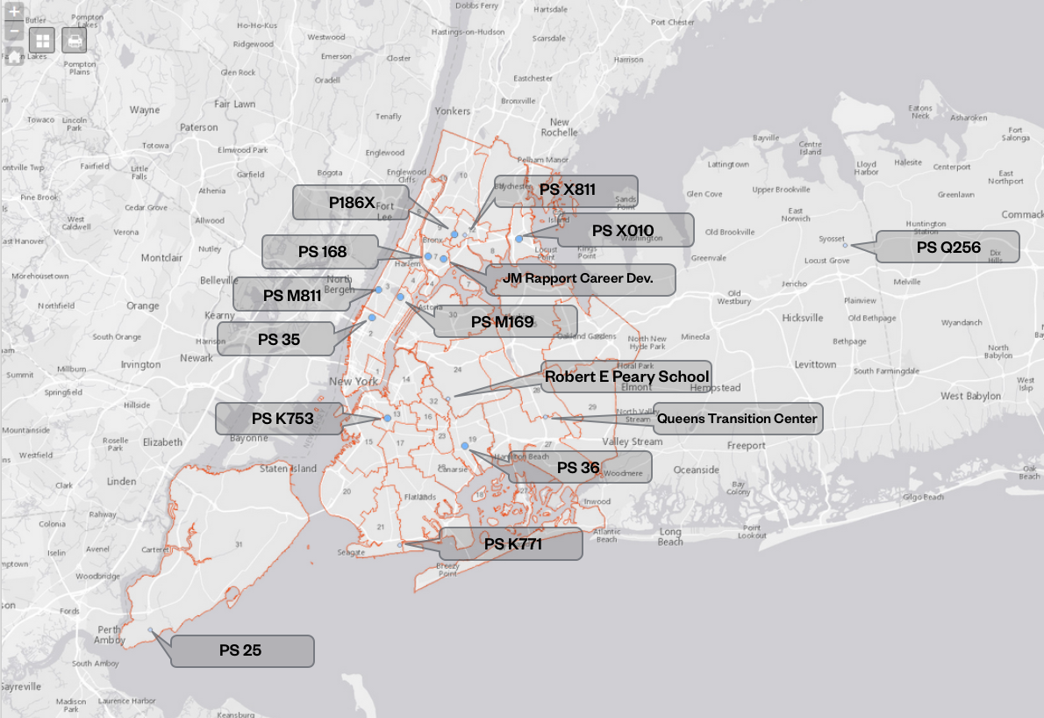
Schools with High Homeless Student
Chronic Absenteeism in District 75
15 schools in District 75 have homeless students with chronic absenteeism rates over 60%.
Source: New York City Department of Education, unpublished data tabulated by the Institute for Children, Poverty, and Homelessness, SY 2015–16.

Slide 18
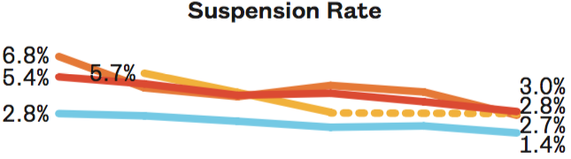
Suspensions of Homeless Students in District 75
Suspension rates among homeless students have declined in the past six years.
In District 75, students living in shelters had the highest suspension rate at 3%.
Source: New York City Department of Education, unpublished data tabulated by the Institute for Children, Poverty, and Homelessness, SY 2015–16.

Slide 19
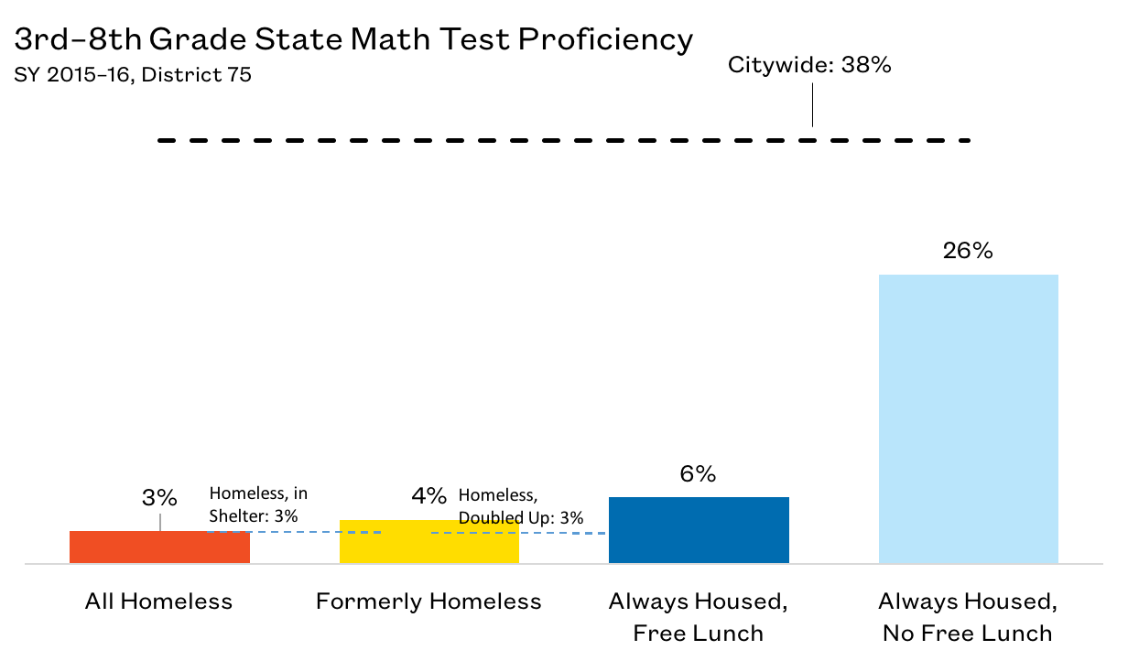
3rd–8th Grade State Math Test Proficiency Rates in District 75
A persistent achievement gap exists for all special education students, with even non-low income housed students scoring below the citywide average (26%).
Students who had been homeless or low income scored well below, with fewer than 5% meeting the proficiency benchmark.
Source: New York City Department of Education, unpublished data tabulated by the Institute for Children, Poverty, and Homelessness, SY 2015–16.

Slide 20
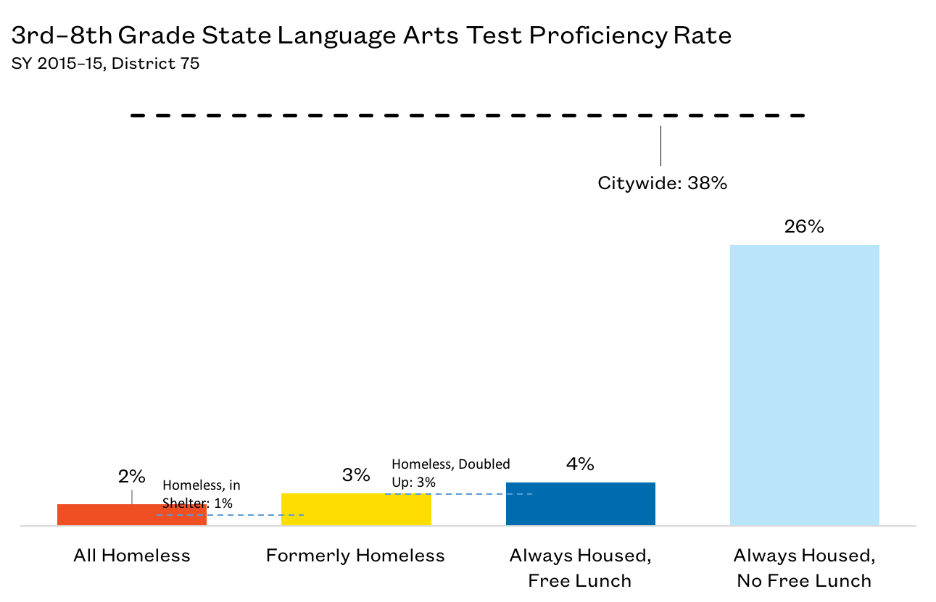
3rd–8th Grade State English Language Arts Test Proficiency Rates in District 75
A persistent achievement gap exists for all special education students, with even non-low income housed students scoring below the citywide average (26%).
Students who had been homeless or low income scored well below, again with less than 5% meeting the proficiency benchmark.
Source: New York City Department of Education, unpublished data tabulated by the Institute for Children, Poverty, and Homelessness, SY 2015–16.

Slide 21
Policy Considerations
Identifying students who are homeless is the first step to ensuring these students receive adequate supports.
School staff should continue to proactively connect and collaborate with parents as well as shelter staff to address the issues of chronic absenteeism and high school dropouts among homeless students.
Ensure school staff are knowledgeable about the various community resources and can effectively direct families to appropriate services (i.e., community health centers, housing assistance, after-school enrichment programs, etc.).

Slide 22
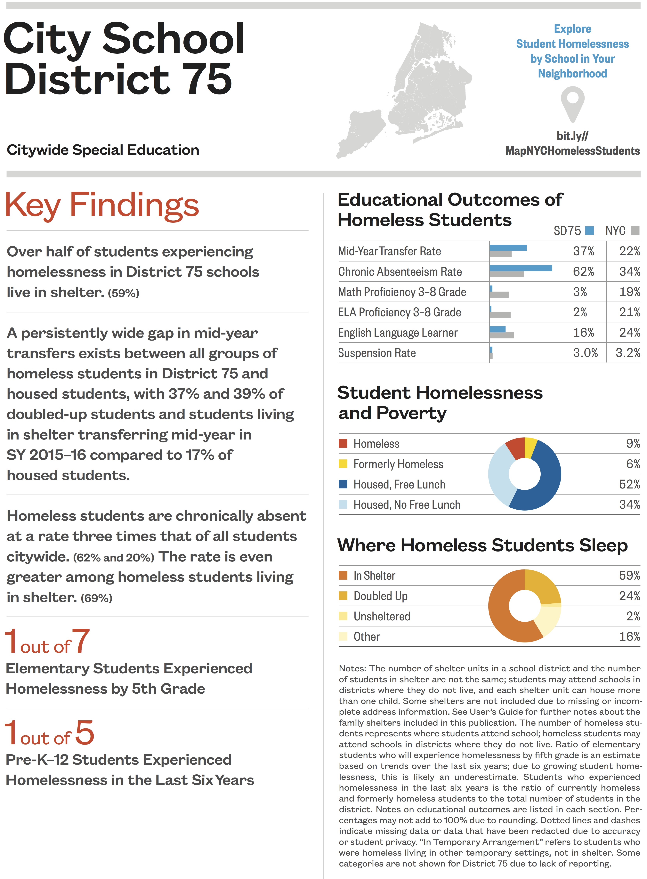
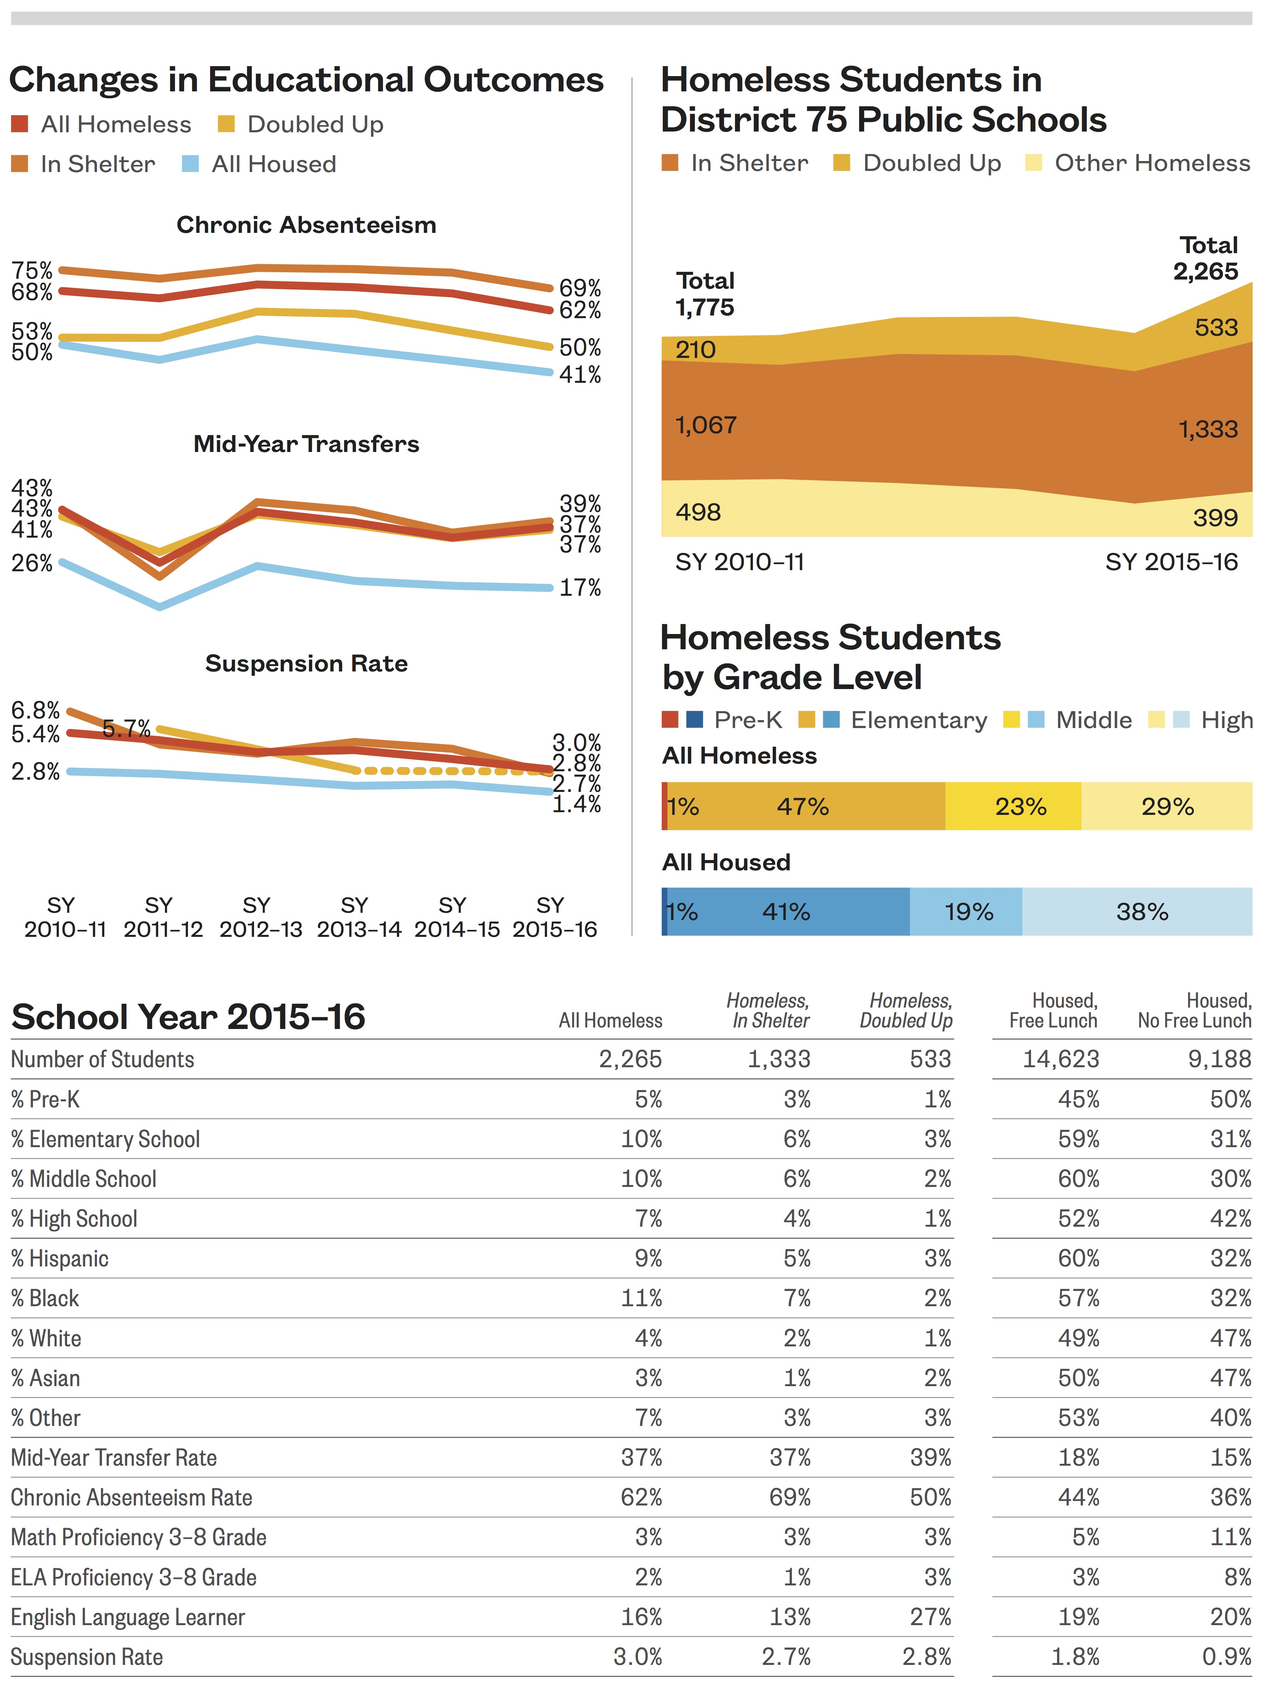

Slide 23
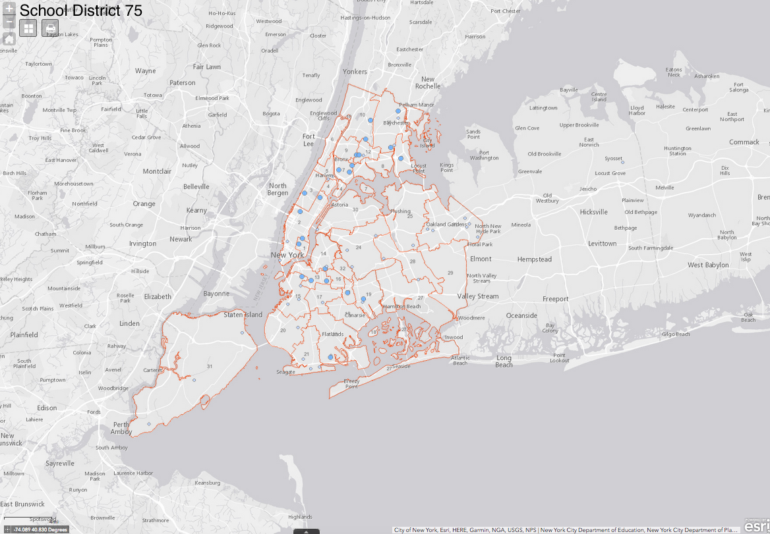

Slide 24
Thank You!
media@ICPHusa.org
212.358.8086
To download copies of our publications:
http://www.ICPHusa.org/publications/reports/

