Slide 1

Student Homelessness in
New York City Public Schools
District 2, SY 2015–16

Slide 2
Student Homelessness in NYC
Nearly 100,000 NYC public school students experienced homelessness during
SY 2015–16.
Unless current trends change,
1 in 7 students will experience homelessness before they finish elementary school.
Source: New York City Department of Education, unpublished data tabulated by the Institute for Children, Poverty, and Homelessness, SY 2015–16.
Notes:
Student Homelessness in NYC

Slide 3
Where Do Homeless Students Sleep?
For every homeless student
living in shelter, roughly two more are homeless living in another temporary
setting—mostly doubled up.
Source: New York City Department of Education, unpublished data tabulated by the Institute for Children, Poverty, and Homelessness, SY 2015–16.

Slide 4
Most Children Are Homeless for More Than One School Year
Homelessness was not a
brief or isolated experience
for students citywide.
Two-thirds of homeless students experienced homelessness during more than one school year.
Source: New York City Department of Education, unpublished data tabulated by the Institute for Children, Poverty, and Homelessness, SY 2015–16.

Slide 5
Young Students Are Most at Risk
Students are more likely to experience homelessness when they are young.
During SY 2015–16, 35% of all homeless students were in grades pre-K through 2nd compared to 28% of housed students.
Source: New York City Department of Education, unpublished data tabulated by the Institute for Children, Poverty, and Homelessness, SY 2015–16.

Slide 6
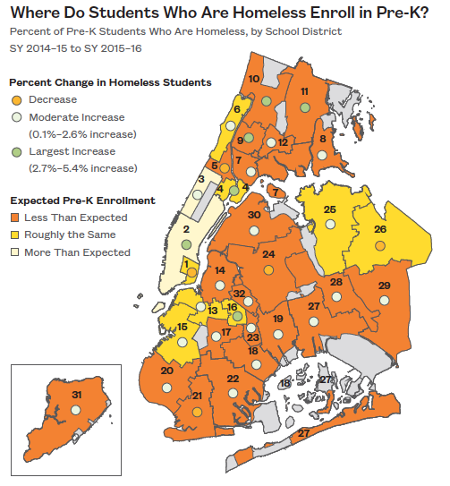
Differences in Pre-K Enrollment
Citywide, pre-K enrollment improved by 17% for children who have been homeless. However, the majority of school districts enrolled fewer homeless pre-K students than would be expected.
Source: New York City Department of Education, unpublished data tabulated by the Institute for Children, Poverty, and Homelessness, SY 2015–16.

Slide 7
Student Homelessness in District 2
Over 4,100 currently homeless students in District 2.
1 in 10 students experienced homelessness in the last six years.
Source: New York City Department of Education, unpublished data tabulated by the Institute for Children, Poverty, and Homelessness, SY 2015–16.
Notes:
School-age children only
Does not include charter schools

Slide 8
Where Do Homeless Students Sleep in District 2?
1,004 students lived in shelters and 2,706 students lived doubled up at some point during SY 2015–16. Another 394 students lived in another temporary setting.
Source: New York City Department of Education, unpublished data tabulated by the Institute for Children, Poverty, and Homelessness, SY 2015–16.

Slide 9
Homelessness and Poverty Among Students in District 2
Among students enrolled, 6% were homeless during SY 2015–16.
Another 4% had been homeless in at least one of the five previous years.
Source: New York City Department of Education, unpublished data tabulated by the Institute for Children, Poverty, and Homelessness, SY 2015–16.

Slide 10
Percentage of Homeless Students in Manhattan Districts
Out of six city school districts in Manhattan, District 2 had the lowest percentage of homeless students enrolled.
Source: New York City Department of Education, unpublished data tabulated by the Institute for Children, Poverty, and Homelessness, SY 2015–16.

Slide 11
Pre-K and High School Students Are Most At Risk
Pre-K and high school had the highest percentage of homeless students in District 2.
Source: New York City Department of Education, unpublished data tabulated by the Institute for Children, Poverty, and Homelessness, SY 2015–16.

Slide 12
Student Homelessness by Race and Ethnicity in District 2
Black students
were most at risk of experiencing homelessness in District 2.
Source: New York City Department of Education, unpublished data tabulated by the Institute for Children, Poverty, and Homelessness, SY 2015–16.

Slide 13
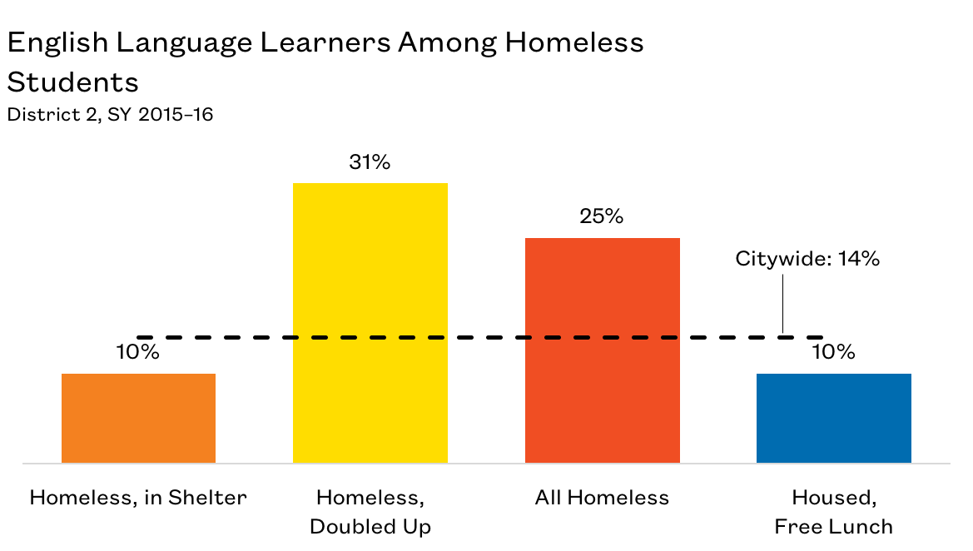
English Language Learners in District 2
1 in 4 homeless
students were English Language Learners.
Source: New York City Department of Education, unpublished data tabulated by the Institute for Children, Poverty, and Homelessness, SY 2015–16.

Slide 14
Impacts of Student Homelessness
  Transfer schools more often
  More likely to be chronically absent
  Lower rates of proficiency on state assessments
  Higher suspension rates
  Lower graduation rates
  Higher dropout rates
  Require additional ELL supports
  Receive late support for special education needs
These impacts last beyond a student’s experience with homelessness

Slide 15
Mid-Year School Transfers in District 2
15% of homeless students transferred schools mid-year.
Students in shelters had the highest mid-year transfers at 19%.
Every school transfer is
estimated to set a student
back academically by
up to six months.
Source: New York City Department of Education, unpublished data tabulated by the Institute for Children, Poverty, and Homelessness, SY 2015–16.

Slide 16
Chronic Absenteeism Among Homeless Students in District 2
Students who are chronically absent miss 20 or more
days of school in a year.
Students living in shelters
had the highest chronic absenteeism rate in District 2.
Source: New York City Department of Education, unpublished data tabulated by the Institute for Children, Poverty, and Homelessness, SY 2015–16.

Slide 17
Chronic Absenteeism Among Homeless Students in District 2
District 2 ranks in the middle
for chronic absenteeism among homeless students citywide.
Source: New York City Department of Education, unpublished data tabulated by the Institute for Children, Poverty, and Homelessness, SY 2015–16.

Slide 18
Suspensions of Homeless Students in District 2
Suspension rates among homeless students have declined in the past six years.
The suspension rate for students in shelters was over three times the citywide rate, 7.6% and 2.5% respectively.
Source: New York City Department of Education, unpublished data tabulated by the Institute for Children, Poverty, and Homelessness, SY 2015–16.

Slide 19
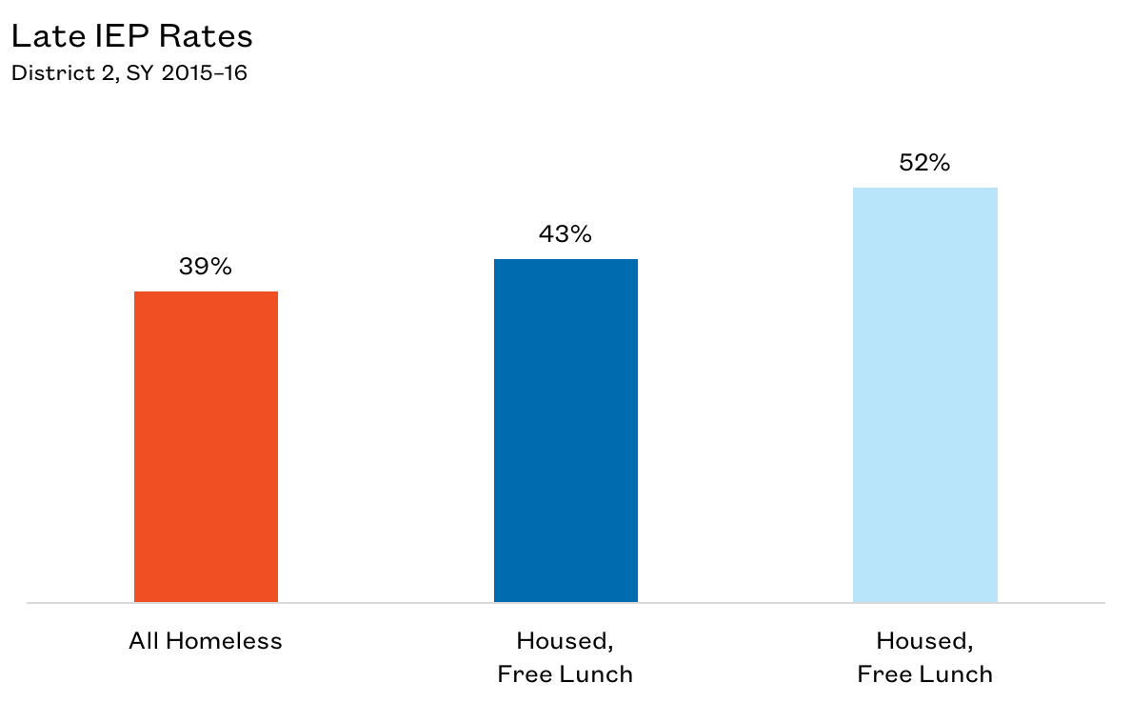
Additional Needs of Homeless Students in District 2
Homeless students receive special education supports earlier in their education compared to housed students.
Source: New York City Department of Education, unpublished data tabulated by the Institute for Children, Poverty, and Homelessness, SY 2015–16.

Slide 20
Additional Needs of Students Experiencing Homelessness
Early identification helps students maintain grade level proficiency and ultimately have a better chance of graduating.
Source: New York City Department of Education, unpublished data tabulated by the Institute for Children, Poverty, and Homelessness, SY 2015–16.

Slide 21
3rd–8th Grade State Math Test Proficiency Rates in District 2
Overall, homeless students exceeded the citywide average in meeting the proficiency benchmark in District 3.
Only 20% of students living in shelters performed at or above grade level.
Source: New York City Department of Education, unpublished data tabulated by the Institute for Children, Poverty, and Homelessness, SY 2015–16.

Slide 22
3rd–8th Grade State English Language Arts Test Proficiency Rates in District 2
The ELA proficiency rate for currently homeless students was at 38% while the proficiency rate for formerly homeless students exceeded the citywide average.
Recognizing homeless and formerly homeless students
as a unique cohort may be the
first step in designing solutions
that meet their needs
and help them overcome educational deficits.
Source: New York City Department of Education, unpublished data tabulated by the Institute for Children, Poverty, and Homelessness, SY 2015–16.

Slide 23
Providing Support and Identifying Opportunities
Citywide, graduation rates for homeless students living in shelter during all of high school were similar to that of low-income housed students.
How can supports be extended to students who are homeless and living outside of shelters?
Source: New York City Department of Education, unpublished data tabulated by the Institute for Children, Poverty, and Homelessness, SY 2015–16.

Slide 24
Dropout Rates for Homeless Students in District 2
The four-year dropout rate for New York City improved slightly from 9.0% for the class of 2015 to 8.5% for the class of 2016, but the achievement gap persisted.
In District 2, homeless students not living in shelters were most at risk of dropping out.
Source: New York City Department of Education, unpublished data tabulated by the Institute for Children, Poverty, and Homelessness, SY 2015–16.

Slide 25
Graduation Rates for Homeless Students in District 2
On average, 73% of New York City high school students graduate within four years.
The graduation rate for homeless students in District 2 was 63%.
Source: New York City Department of Education, unpublished data tabulated by the Institute for Children, Poverty, and Homelessness, SY 2015–16.

Slide 26
Policy Considerations
Identifying students who are homeless is the first step to ensuring these students receive adequate supports.
School staff should continue to proactively connect and collaborate with parents as well as shelter staff to address the issues of chronic absenteeism and high school dropouts among homeless students.
Ensure school staff are knowledgeable about the various community resources and can effectively direct families to appropriate services (i.e., community health centers, housing assistance, after-school enrichment programs, etc.).

Slide 29
Thank You!
media@ICPHusa.org
212.358.8086
To download copies of our publications:
http://www.ICPHusa.org/publications/reports/

